Slide 1


Slide 1
Sales Analysis
Presented By :- Sarthak Salvi

Slide 2


Slide 2
Agenda
Introduction to the Business Case
Data & Tool Overview
Problem Identification
Deep-Dive Analytics
Strategic Recommendations
Conclusion
2

Slide 3
Slide 3
Business Background
Nova Essentials is a retail firm operating across regions
Focus on product sales, customer behavior, and regional performance
Management needed insight into declining profits, low-performing areas, and growth opportunities
e
3

Slide 4

Slide 4
Objective
Transform raw data into actionable insights to solve business pain points.
Detect unprofitable products & customers.
Understand region-wise performance.
Identify sales decline patterns.
Propose targeted strategies.
4

Slide 5

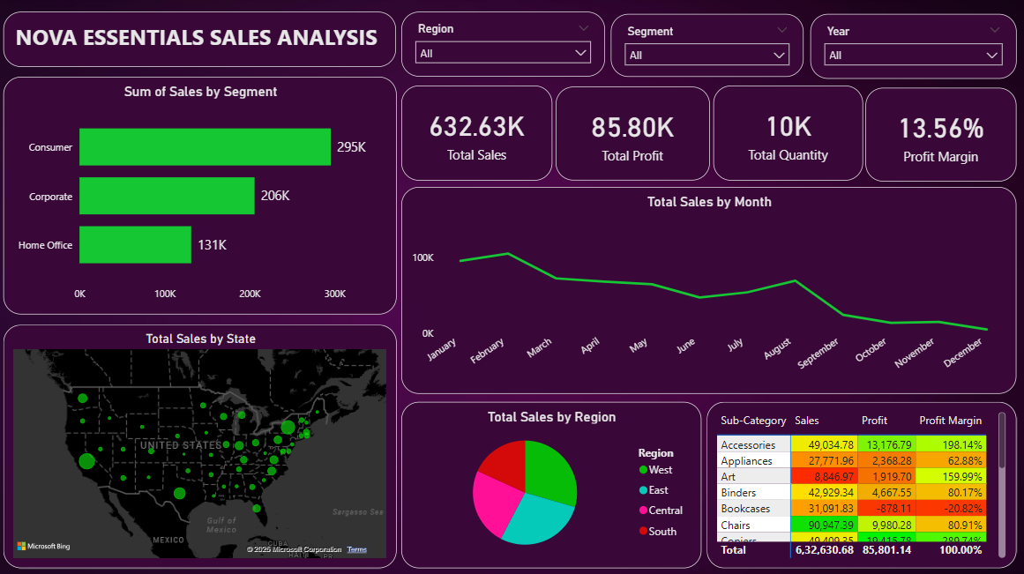
Slide 5
Dashboard Overview
5

Slide 6
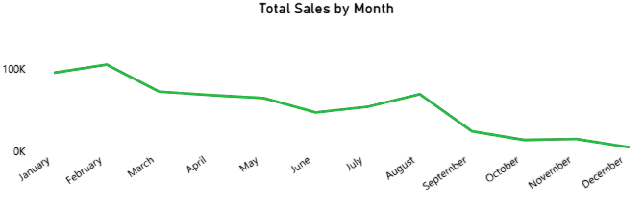
Slide 6
Problem 1 : Sales Drop in Q4
Observation: Sales drop from September to December
Root Cause: Lack of promotions, drop in corporate orders
Solution: Q4 discount campaigns, re-engage corporate clients
6

Slide 7
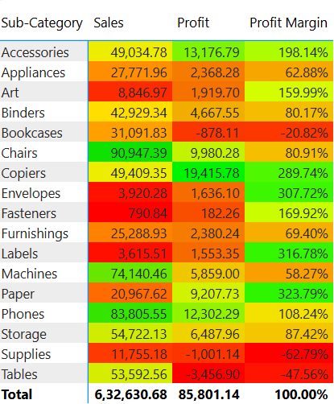
Slide 6
Problem 2 : Unprofitable Sub-Categories
Insight: Tables, Bookcases, Supplies show negative profit margins
Action Plan: Review pricing, discontinue low-margin products, bundle with profitable ones
7

Slide 8
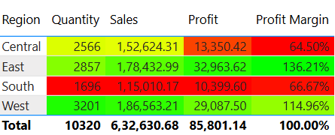
Slide 6
Problem 3 : Regional Imbalance
Insight: East & West performs best, Central & South underperform.
Solution: Improve marketing and supply in low-performing regions
8

Slide 9
Slide 9
Strategic Recommendations
Discontinue or fix unprofitable SKUs
Launch Q4 promotions
Promote high-margin products
Enhance regional sales
9

Slide 10

Slide 11
THANK YOU

